Slide 1
Welcome
to my project presentation

Slide 3
Introduction
This project aims to analysis how the members of study hours impact academic performance, how students habits, accommodation, gardian’s occupation, mentor influence grades.

Slide 4
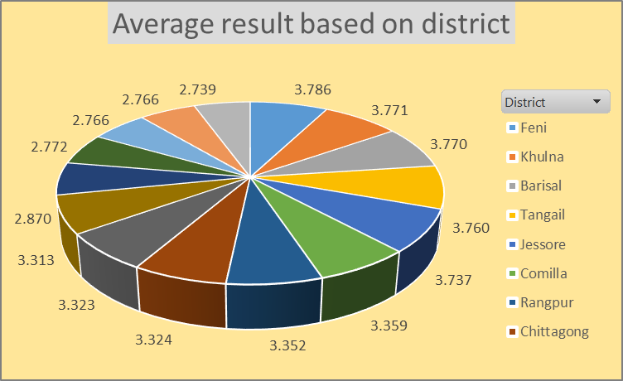
1. Firstly I want to show the average of results based on district. The result is high in Feni and low in Gazipur.

Slide 5
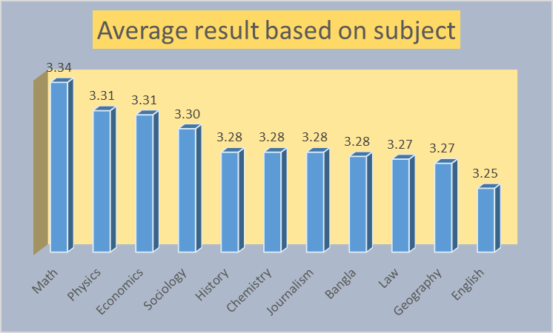
2. The average and best results in a district for differnt subject,including math.To provide a clearer analysis,for all subject

Slide 6
3. Here I make a pivort table and chart based on the mentors. The students under Karim Hossain do well. Saiful Islam & Jahanara Alam are mentoring most students.

Slide 7
4. Here I want to show the results based on student's study hours. The students who study 10 hours per day, they make good result. Some students also make good result by studying 3 hours only per day. And these kinds of students are most. They are 16. There are 11 students who study 12 hours per day but their results are not so good.

Slide 8
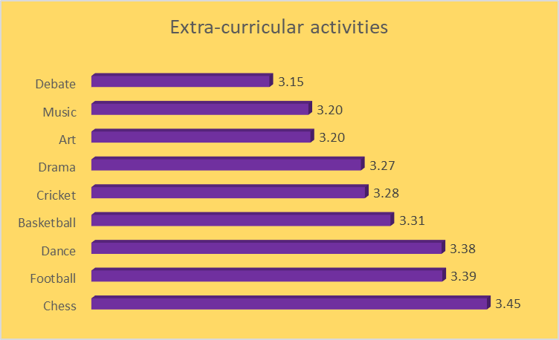
5. Here I analysed results based on student's extra-curricular activities. The students who play Chess, make good result. The average of their results 3.45

Slide 9
6. Here I analysed the results based on students guardian's occupation. The children of rickshaw puller do well.

Slide 10
Thank You

